Slide 1

Code Explanation
Pierre Quentin Ngandjui Tiako

Slide 2
Mongo DB vocabulary
Document : name of a data stored in the database. They are represented a a JSON like format
Collection: Set of documents
MongoDB Query is a way to get the data from the MongoDB database. MongoDB queries provide the simplicity in process of fetching data from the database, it's similar to SQL queries in SQL Database language
Mongo Shell : Mongo Client to interact in command line with your Mongo DB server
Mongo DB Compass: a graphical interface to observe and interact with your database

Slide 3
Software / functional architecture
Mongo DB server
Observe the database
Apply modifications to the DB
Do small modifications for tests
Load Data from the DB
Mongo Compass (Client)
Load Data
Upload Data
Initialize the database
MATLAB Code
Python Code

Slide 4
MongoDB installation process (local)
Download link: https://www.mongodb.com/try/download/community
Install the version for the system where the Mongo DB will be host

Slide 5
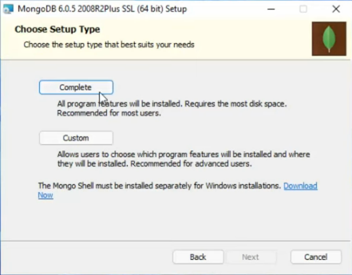
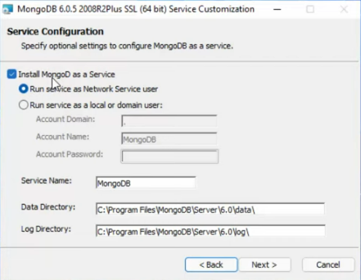
Windows Case
Keep the given paremeters, complete installation and run as a service (in this case is to ensure Mongo DB will start at the start of your machine)

Slide 6
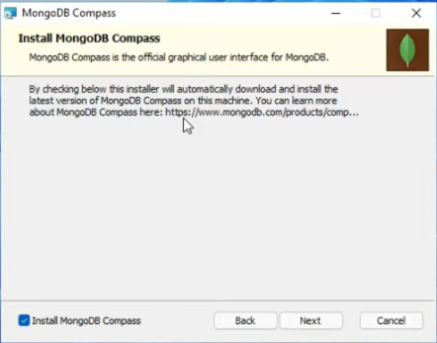
Windows case
Keep the installation of Mongo DB Compass, very useful for small modifications or observing the effect of your code on the database

Slide 7
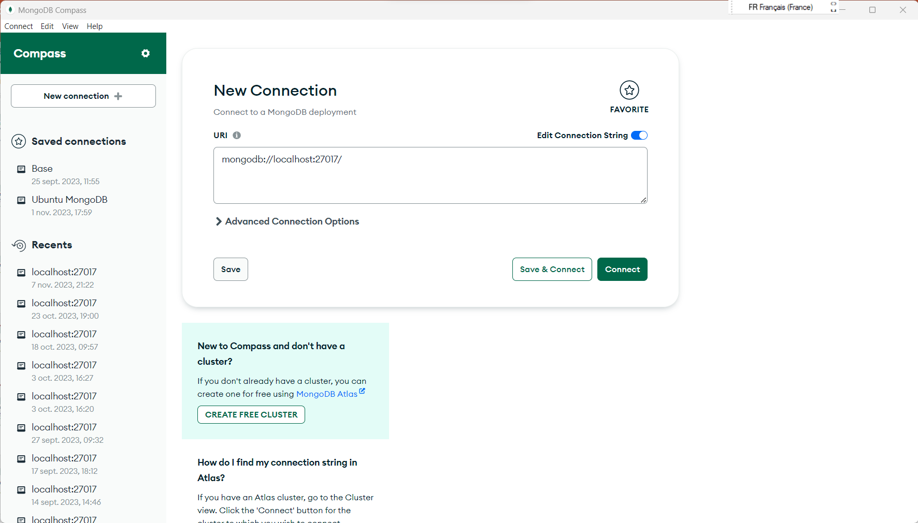
Mongo DB Compass
When Mongo server is installed locally, you don’t have to modify anything
Just connect to: mongodb://localhost:27017/

Slide 8
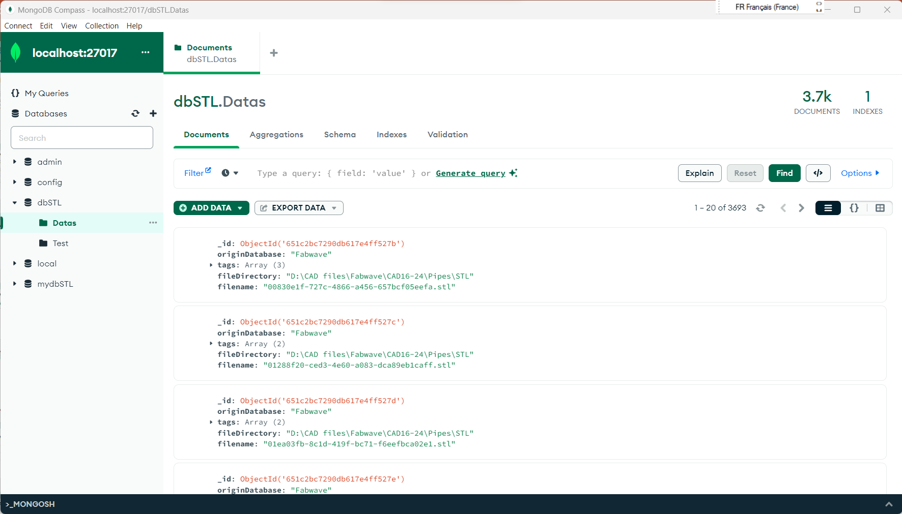
Mongo DB Compass
Here you can see directly the effect of your program on the database
Manually make some change for testing
Even test the results of queries

Slide 9
MongoDB Query
There is a lot to know about Queries, how there are written and the operators that can be applied to them.
For now there will only be the form of queries that will be used for a specific case: look into a list of tags
For more information look into the documentation: https://www.mongodb.com/docs/manual/tutorial/query-documents/

Slide 10

A simple query
Objective : Apply a filter on one field
Fieldname
Value
Fieldname
Operator
Value

Slide 11
The difficulty when writing queries
To automate the writing of queries in matlab one simple way is to write a structure and then convert it in a json format
But the essential character ($) for the properties are not allowed as a fieldname for a structure
So different functions was written (see QueryManager)

Slide 12
How to update the value of a field
{ $set: { <field1>: <value1>, ... } }
The first and simplest ways to update the value of a field in a document in the DB
Also have the property to add the field to the document if it doesn’t exist already

Slide 13

Case 1: we want to see if the tags array contains ONE specific value
Easiest case, just a struct / queries with the field and the specific value
In this case, the only dtas that will be load are the one where the tags list contain the value « Mechanical component »

Slide 14
Case 2: we want to load data where the tags array contain multiple specific elements
If the query is written like this, it will only load the data where the values « red » and « blank » are in this specific order in the tags array
In this case, it will load the datas where the two values are in their tags array but the order or position of the values in the array doesn’t matter

Slide 15
Case 2:
In this case, every document / data that contain at least one of the cited element (« home », « school ») will be loaded
More documentation:
https://www.mongodb.com/docs/v3.4/tutorial/query-arrays/
https://www.mongodb.com/docs/manual/reference/operator/query/in/

Slide 16
Code Structure (1)
Python code
Class MongoDBManagement with functions to deal with the upload and loading of the datas in the database
Need to install pysftp on your computer
MongoDBManagement.py
Properties
mongo_db
The connection to the database initiate by the mongo_conn method
Methods
__init__(self, mongo_hostname, mongo_port, mongo_dbname)
Constructor
def mongo_conn(self, hstname, prt, db):
Instantiate a connection to the database
create_document_to_upload(self, original_database, file_directory, filename, tags):
Create and give the model of the document that will represent the CAD files in the database
create_tags_for_document(self, actual_dir):
Function to instantiate the tags and source_database of a given CAD that respect the organization given after, by using the path to access the CAD

Slide 17
Code Structure (1) 2
Python code
MongoDBManagement.py
Methods
create_all_documents_for_local_storage_case(self)
By looking into the folder where all the CAD are stored in local, when finding an « .stl » file the method will create an appropriate document to store the reference of the CAD
create_all_documents_for_remote_storage_case(self)
Same as create_all_documents_for_local_storage_case(self) but the files are stored remotely and we use pysftp and not the os python library
upload_documents_to_db(self, posts, dir_name)
Upload one or more documents to the database , in a specific collection
find_data_in_database(self, query, collection, fields_to_include={}, isremote=False, localpathtodownload="")
Load the datas from a specific collection that respect the query conditions. We can precise which fields of the documents we want (fields_to_include). Also if the datas are stored remotely, they are downloaded to the specific local path to download

Slide 18
Files organization for Python upload code (local or remote)
Manipulation object databases
Root folder
Fabwave
Folders name after the source database of the CAD
ABC
Two types of source: with classified by name CAD or non-classified CAD
Fabwave
Bearings
Directories name after the component name
Bolts
Classified by name example

Slide 19

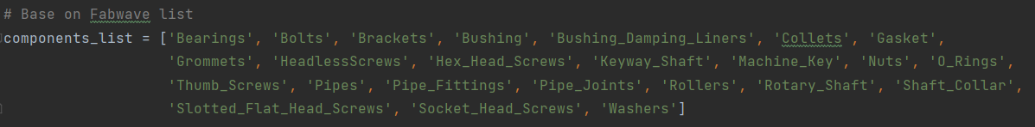
Code modifications to apply when creating a mongo DB with others sources than those provided (1)
1. Create a directory name after the new source database
2. Put your CAD in the directory (Keep the classification given by the source if there is)
3. Add the name of the source database here
4. Add the list of components tags unique to the classification of the new source database

Slide 20
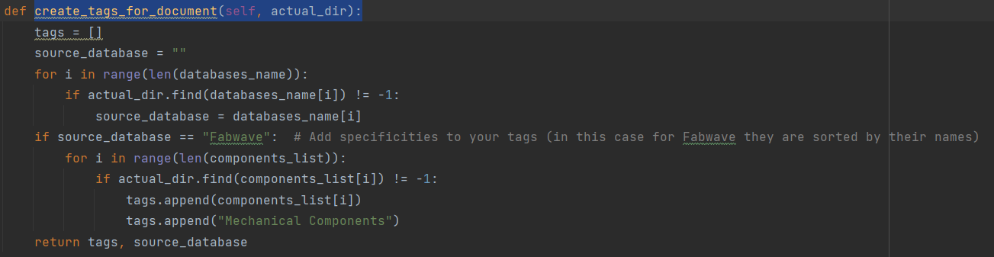
Code modifications to apply when creating a mongo DB with others sources than those provided (2)
Sometimes the new source offers some specific tags that could be interesting to precise
It could be add using the create_tags_for_document(self, actual_dir) in the form mention below

Slide 21
Code Structure (2): Matlab part
In Bold are the objects
Matlab management code
QueryManager.m
Main_import_remote_datas.m
Main_import_local_datas.m
JSONWriter.m
ImportData.m
AutomatePositionning.m
Arrange_escape_character.m
Main_import_local_datas.m
AddBoundariesLimitsToDataInDB.m

Slide 22
QueryManager
To give access to the necessary tools to write simple queries for MongoDB
Objective: Given a structure corresponding to the value we are looking for in a specific field, we rewrite it (adding sometimes certain properties) to obtain the json-like query for the search function in the database.
Properties
array_operators = {'"in"' '"all"' '"set"' '"push"' '"each"'}
A Cell array of the principal operators principally used in our case. Just update it with the wanted operators that will be used later
Methods
convert_from_struct_to_query(obj, struct_to_convert)
From a structure containing the operators without the char $,it creates a query and add the necessary char $ at the willing position. After converting the struct into a JSON like string, it will look for the positions of the operators that are stored in array_operators and add them the char $

Slide 23
QueryManager (2)
test.set = struct("boundaries", [-10 3]);

Slide 24
JSONWriter
Objective: To write the JSON files necessary for the positionning
Methods
write2jsonfile(~, filename, struct2write)
For a better management of the documents when load in matlab, they are stored into structure array. And the end there is a need to write the reference to the CAD into a JSON file for the next steps of the training.
And so this function take the file by the filename (or create it) and write the reference of the CAD in it

Slide 25
ImportData
Objective: Object to use the « find » function of mongo DB in specific ways
Properties
field_positionning = ["usecase" "position"]
As there will be case of the steps for the positionning of a CAD for a specific usecase are stored in the DB, we stored the name of those fields that we want in the results after loading if they are present.
Methods
import_from_one_collection(~ ,mongodbconn, collectname, varargin)
Going further all documents of the database will not certainly have the same fields, and when it is the case the type of variable (cell array or struct array) in which they are stored in matlab can vary. This function is to homogenize it.

Slide 26
AutomatePositionning
Objective: Object to compute the different operations to obtain automatically the repositionning vectors
Properties
y_measure = 1
Standard unit value (same as in original code)
obj_processing_target_fields = {'indv_transf_steps_orientation', 'indv_transf_steps_position'}
Name of the final field where to stored the transformation steps for orientation and translation
pc_fingerbase_data
As the CAD is position in regard to the fingerbase, we need to store the fingerbase datas (pointcloud etc) to not replot it each time
ipfb_obj
Contain the object with the entire preprocessing of the fingebase
pc_import
Store the object that deals with the importation of STL files in matlab
json_writer
Store the object that deals with the creation of JSON files

Slide 27
AutomatePositionning (2)
Methods
center_pc_to_transform(obj, pc_filename)
To center the pointcloud we want in regard to the fingerbase
compute_transf_steps_rotation(obj, pc_targetobj)
Compute automatically the orientations steps by a simple though ( to aligne the longer boundary with the Z axis)
compute_transf_step_translation(obj, pc_rotatedobj)
Compute the translation steps part
json_operation_gen(obj, obj_name, pc_targetobj_filename)
Create the JSON for the given object
create_fingerbase(obj)
As the name said , load the pointcloud of the fingerbase and preprocess it
transform_multi_steps(obj, repos_steps, pointcloud_base)
Execute the differents steps of the transformation in order

Slide 28
AutomatePositionning (3)
Methods
calc_repos_centering_steps(obj, pc_targetobj, pc_fingerbase)
Compute the steps need for centering of the pointcloud in regard to the fingerbase
calc_mid_coordinate_point(~, pc_coord_limits)
Estimate the center of the pointcloud with the Xlimits, Ylimits and Zlimits
transform_single_step(obj, pos_vec, rot_vec, ptcloud_origin)
Apply the transformation need for a single step to the pointcloud
create_rotation_matrix(~, rot_vec )
Compute the rotation matrix for the rotation step

Slide 29
AddBoundariesLimitsToDataInDB
Objective: Not necessary, but if the proportions of your CAD are an interesting factors of filtering, you can use this function to add this property to the datas to the database
Properties
mongodb
Store the object for the Mongo DB connection
list_documents
List of all the documents in the database
list_collections
List of the collections in the database, one in this case
list_documents_and_boundaries
Array of struct with the reference of a CAD and the attributed boundaries

Slide 30
AddBoundariesLimitsToDataInDB
Methods
AddBoundariesLimitsToDataInDB(database, collections)
Constructor of the object
findAllDocuments(obj)
Load the references of all the CADs present in the DB
computeBoundariesForAllDatas(obj)
Compute the references of the loaded datas
updateBoundariesInDB(obj)
Update in the DB the references of the datas

